Slide 1

Steam API for game recommendation

Slide 2
Team Members
Zijian Chen
Xueming Feng
Lu Liu
Chengjun Wu
Zhongmin Yao
Honghao Zeng

Slide 3
Why this is a good idea?
Organize user information
Expand social network
Bring friend and game recommendation
Improve user gaming experience

Slide 4
Main language and tool
HTML
JavaScript
CSS
Vis.js
Graph.js

Slide 5
Main function
Analyze user’s gaming time
Analyze user’s gaming category
Analyze user’s social network
Friend recommendation
Game suggestion
Game reviews
Create chart

Slide 6
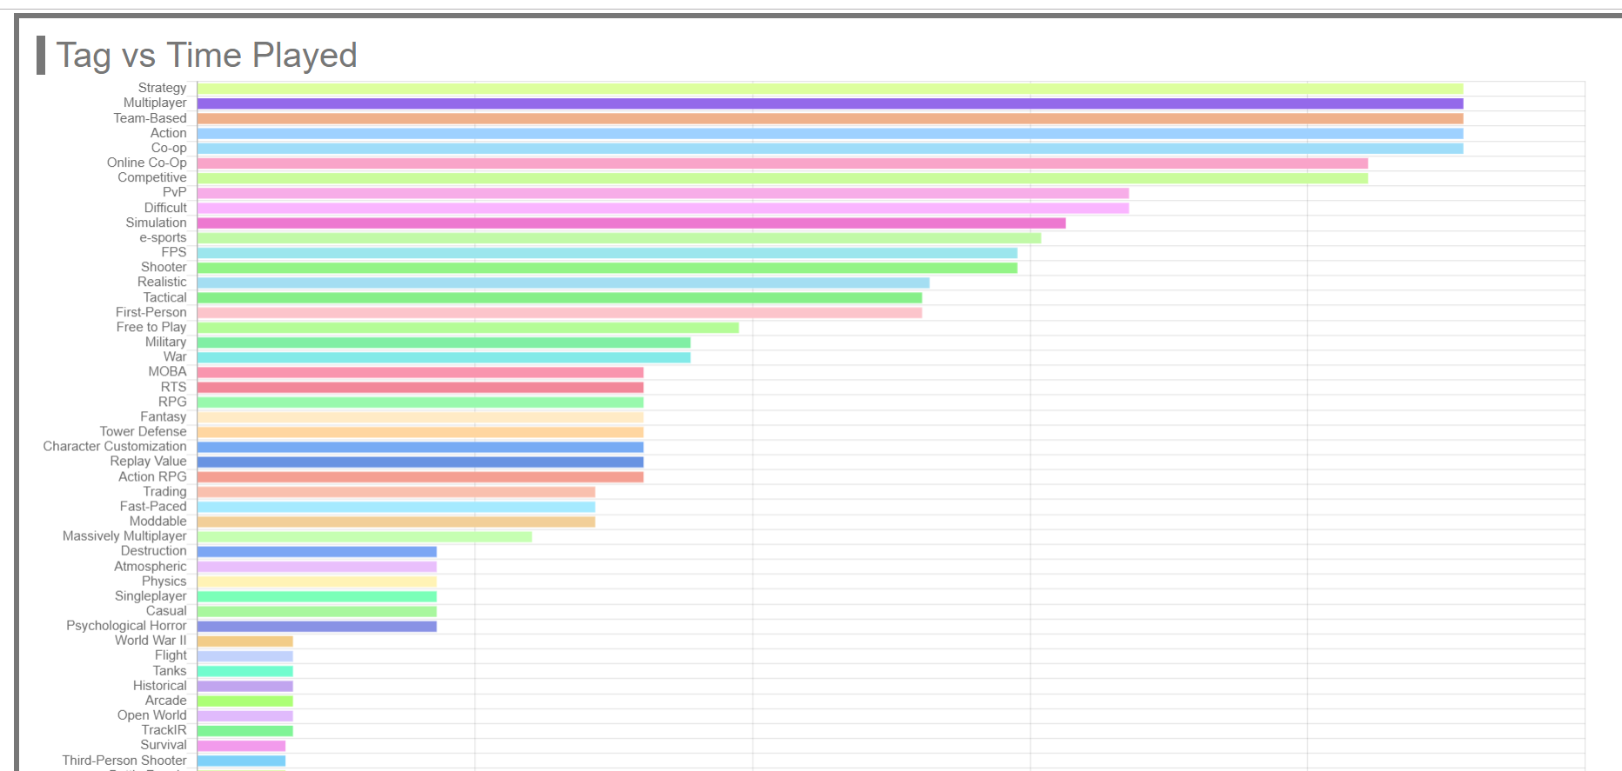
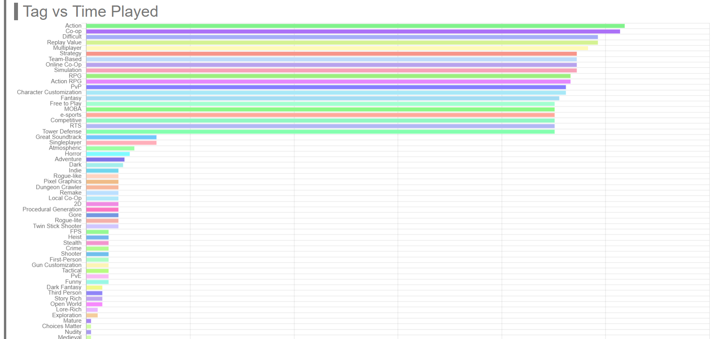
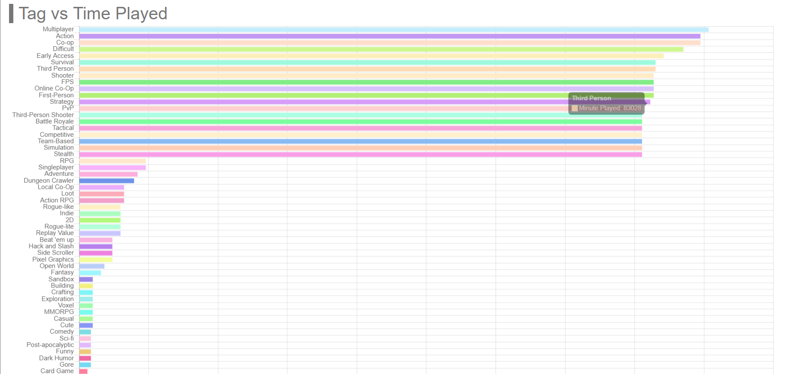
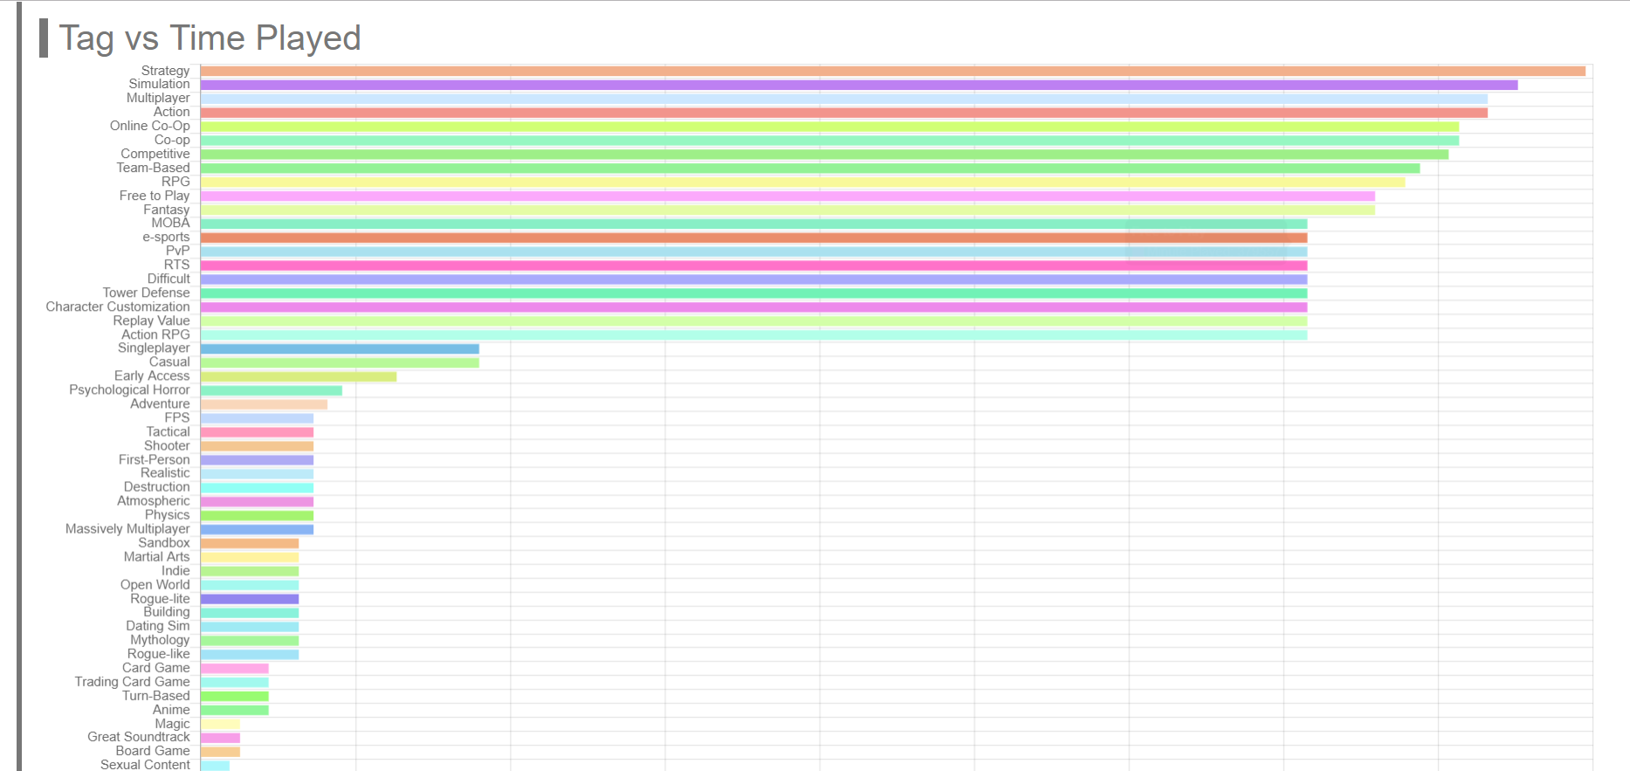
Example of gaming category analyze
User ID: Kiramio
User ID: Incfex
User ID: Understan
User ID: sbwwq

Slide 7
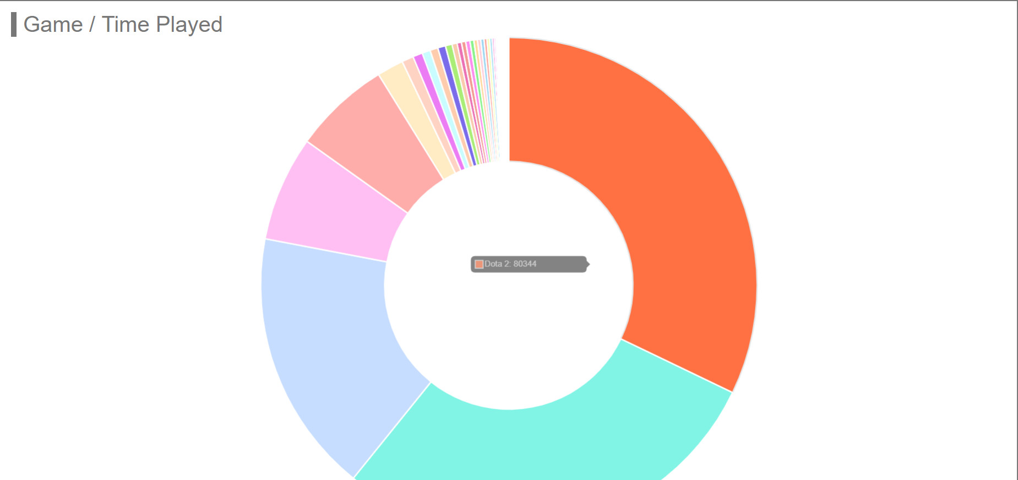
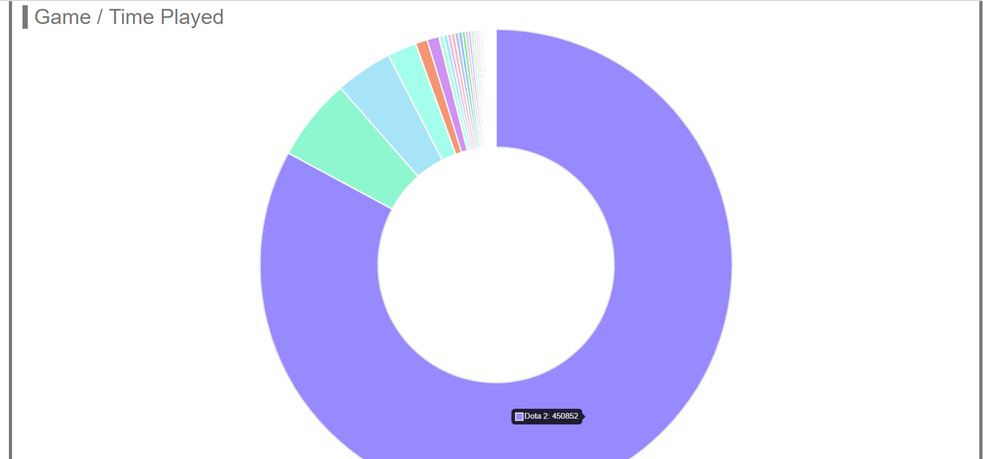
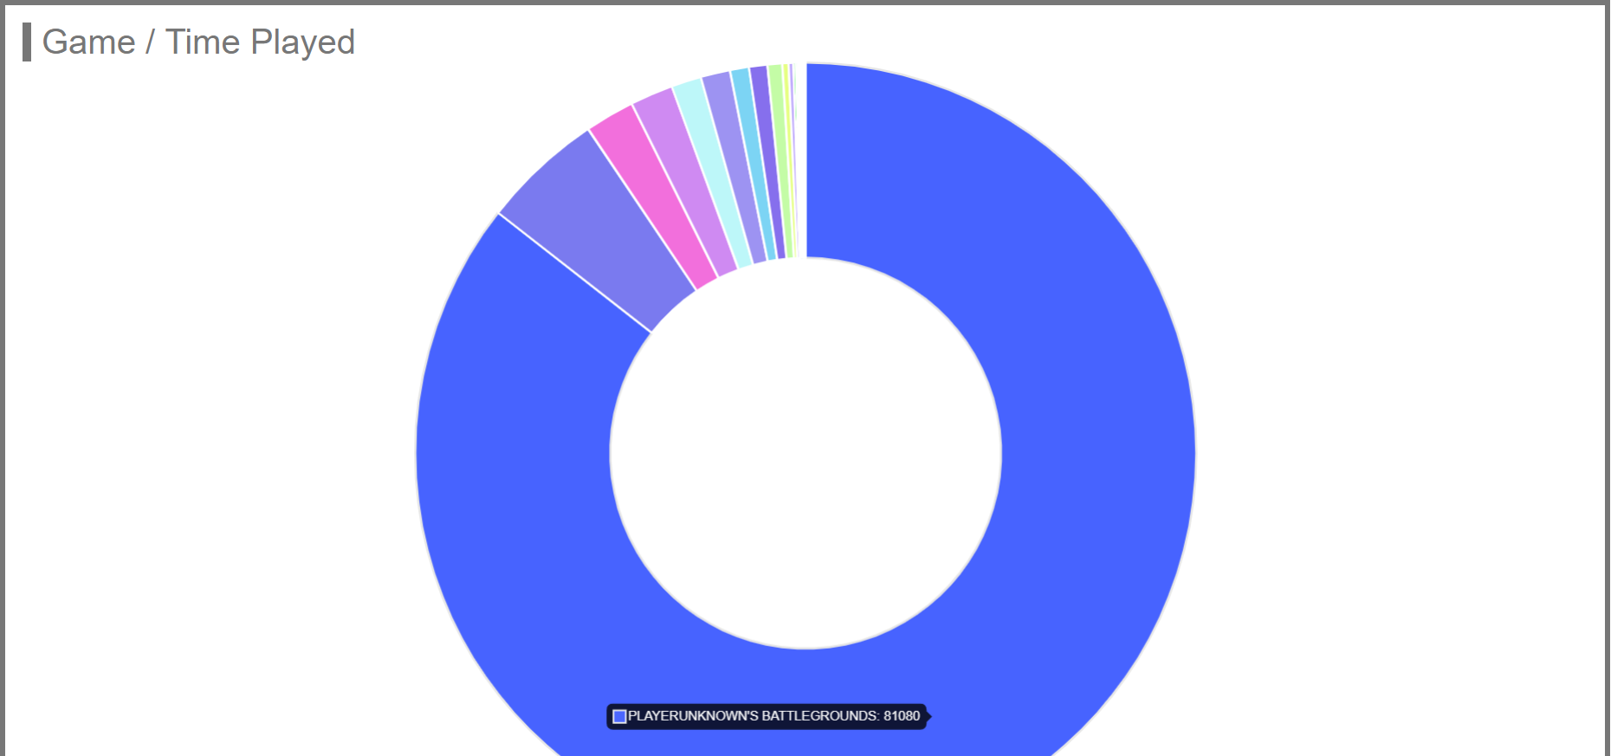
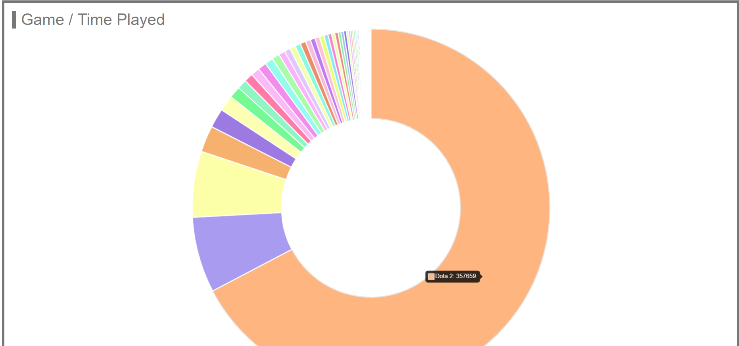
Example of gaming category analyze
User ID: Kiramio
User ID: Incfex
User ID: Understan
User ID: sbwwq

Slide 8
Example of gaming category analyze
Provide graphs for a user’s gaming time based on category
Provide graphs for a user’s gaming time based on the games he/she owned

Slide 9
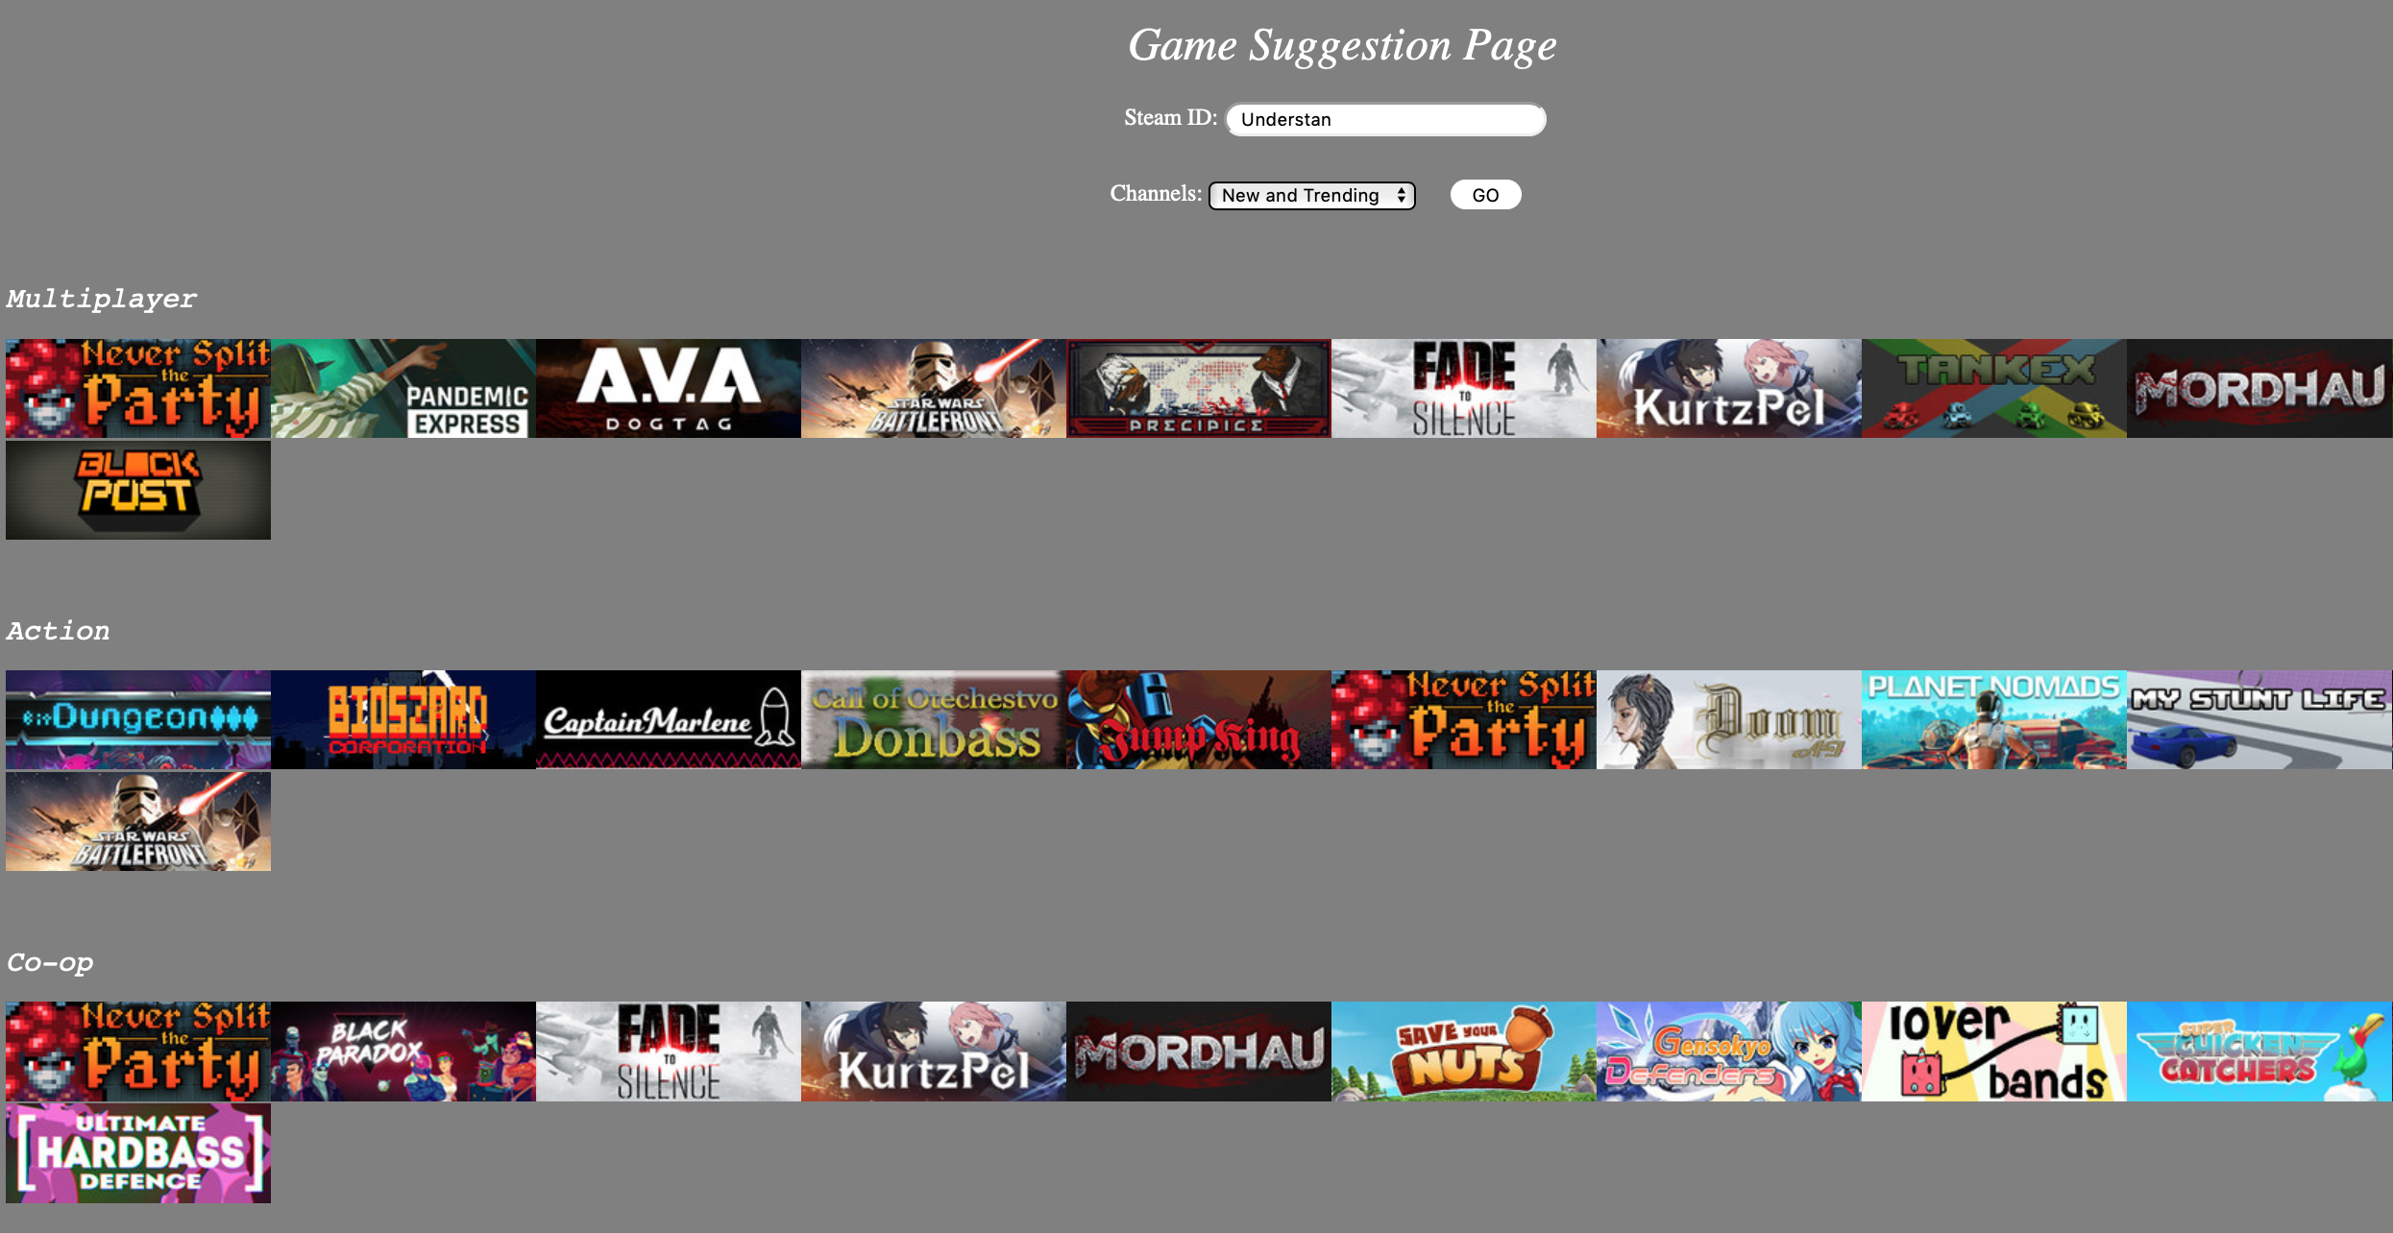
Example of gaming suggestion
User ID: Understan

Slide 10
Example of gaming suggestion
Provide games suggestion base on the channel the user choose
Show the game category
Show the picture of the games

Slide 11
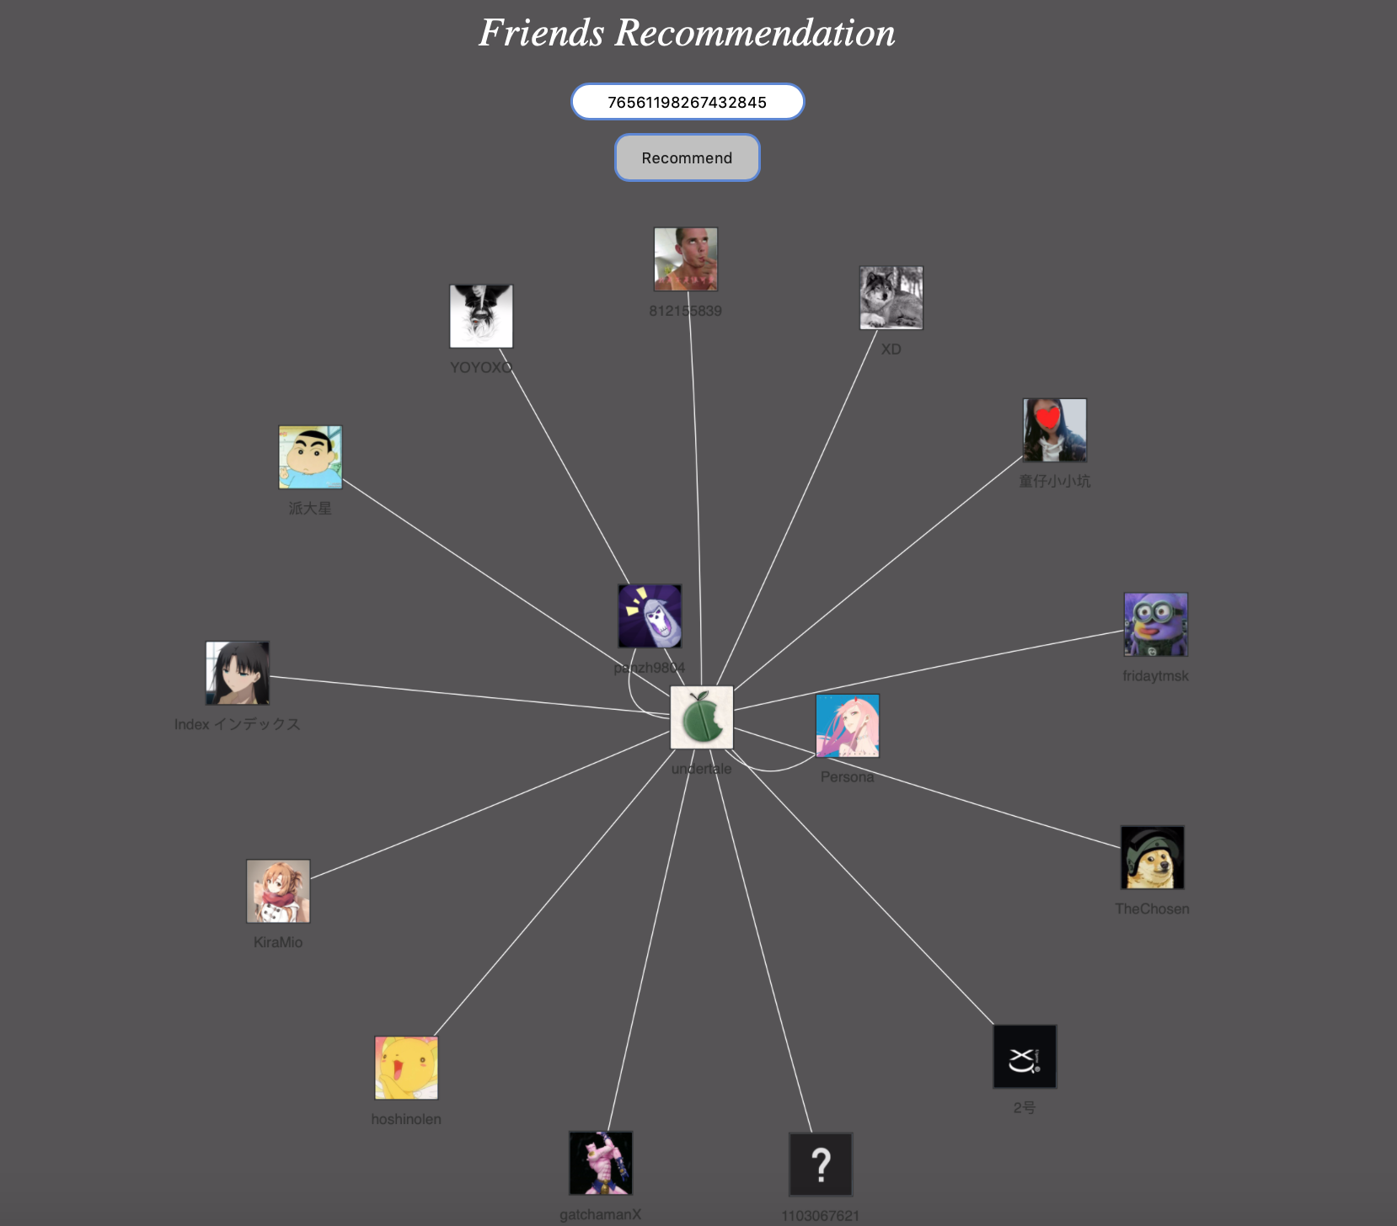
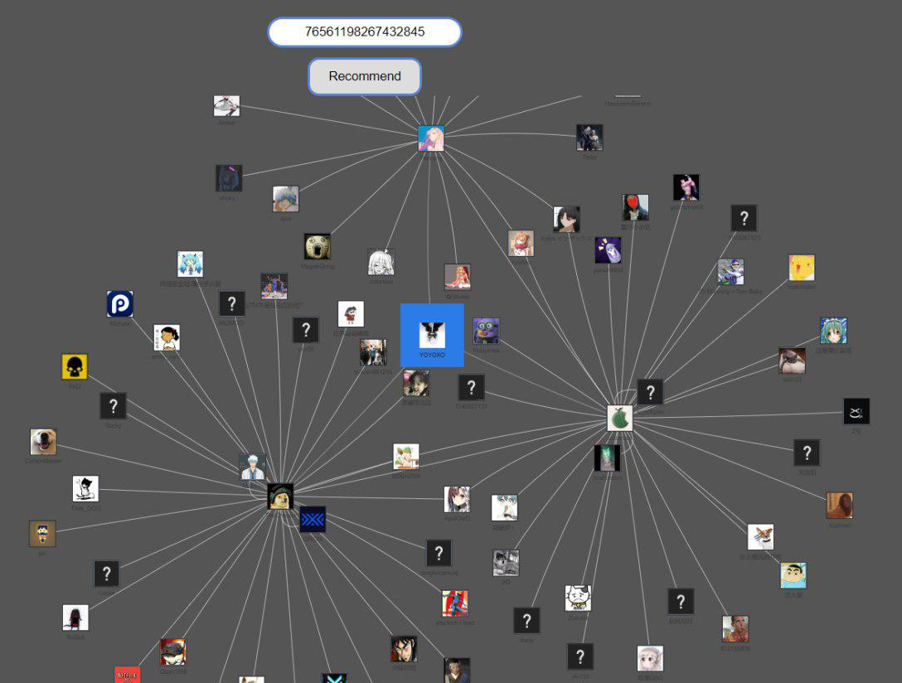
Example of friend recommendation
Understan’s friend network
Understan and his friend’s friend network

Slide 12
Example of friend recommendation
Provide friend network graph base on the user ID
Show user ID and icon
Allow the user to click the icon to extend the network graph
highlight the recommended friends

Slide 13
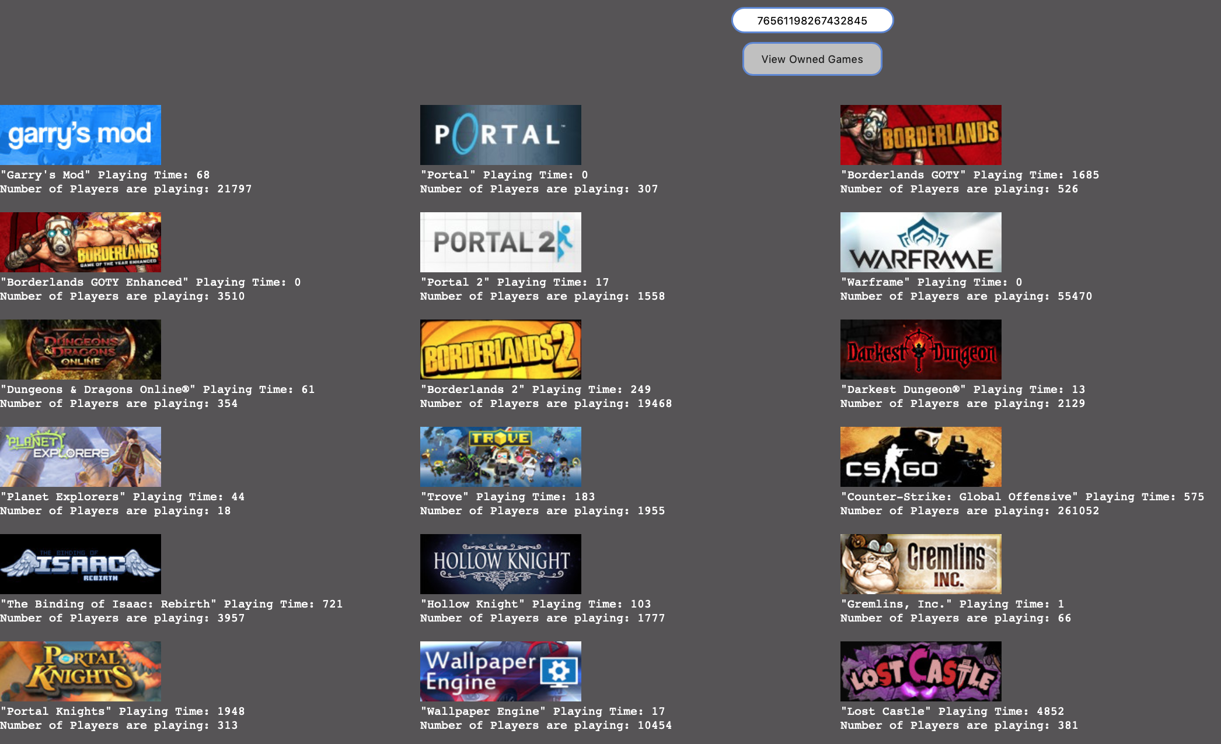
Example of gaming time
User ID: Understan

Slide 14
Example of gaming time
Provide games time base on the user ID
Show the game time
Show the picture of the games

Slide 15
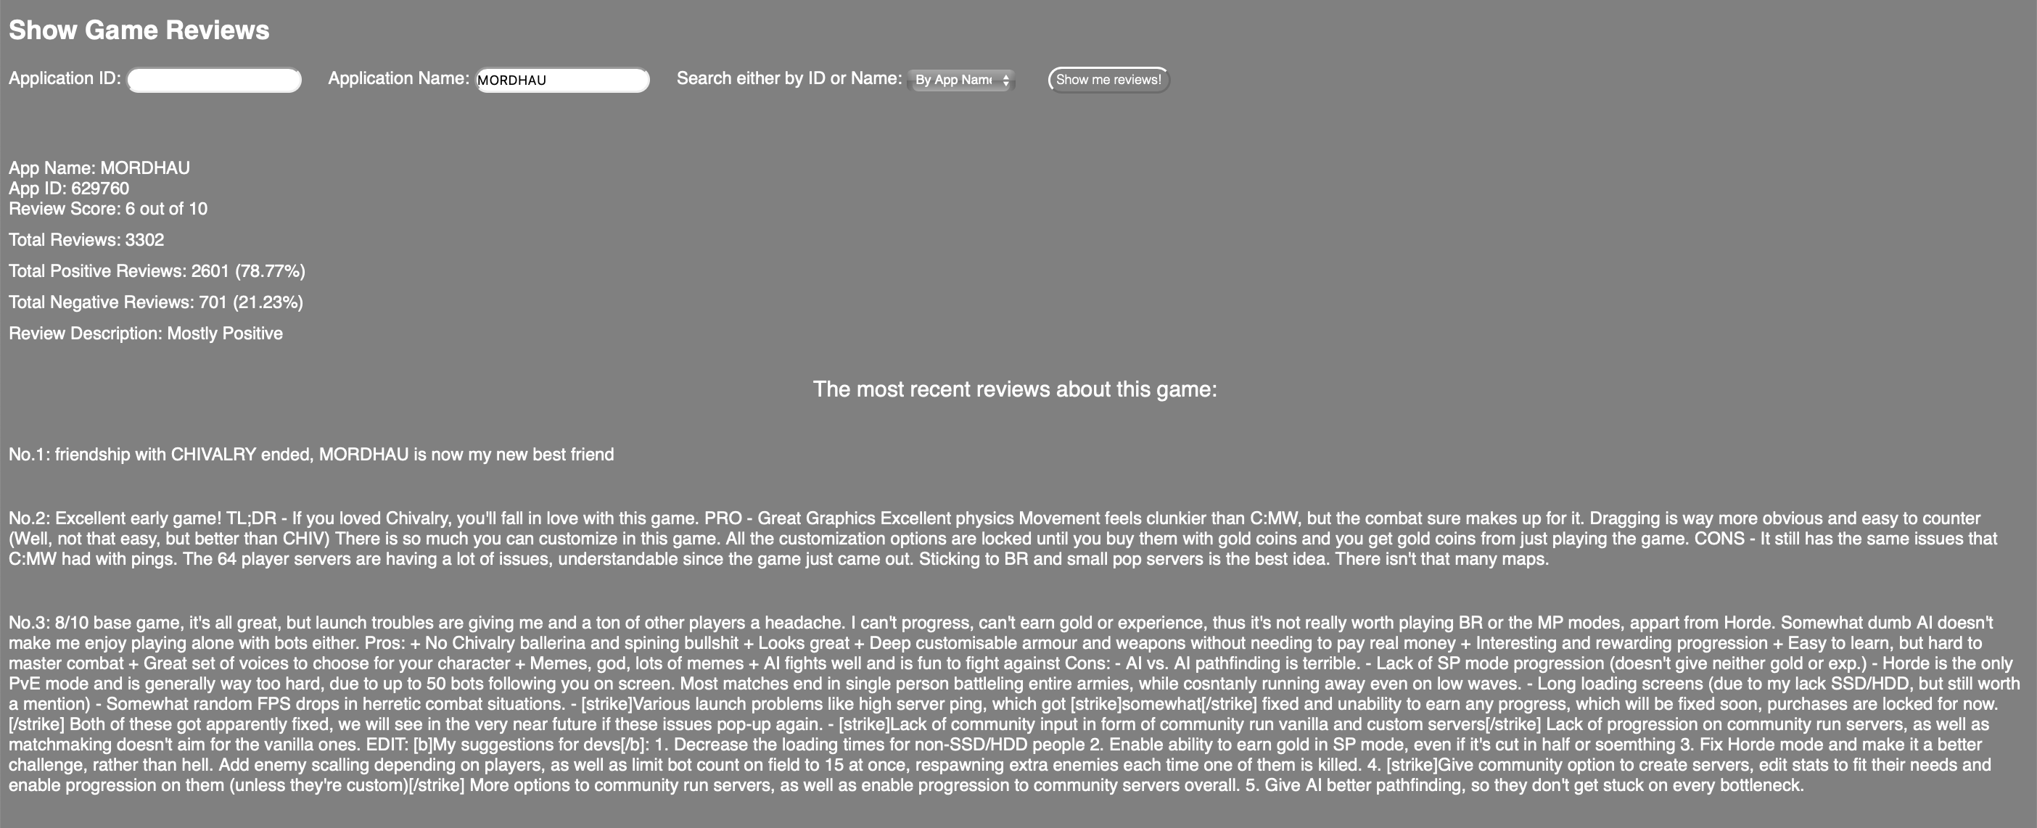
Example of gaming reviews
Game Name: MORDHAU

Slide 16
Example of gaming reviews
Provide games review base on the game ID or game name
Show the game name, score and reviews

